Slide 1
Focused Proofreading: Efficiently Extracting Connectomes from Segmented EM Images
Stephen M Plaza
As presented by Sandra Weiss on January 11th, 2015

Slide 2
Summary
How does the brain work?
EM reconstruction – Identifying neural circuits
Finding neurons and their synapses (connections)
Connectome extraction is difficult
How can the current methods of extracting connectomes from EM data be improved?
Focused proofreading – focus on the most important regions of the EM data
Notes:
Big question: How does the brain work?
Difficulties: a lot of detailed EM data, time consuming to identify neural circuits (especially when done manually by tracing, called proofreading).
Uses automatic segmentation, then focused proofreading on the most important parts of the connectome (e.g. synapses) and the parts that are most likely to be incorrectly segmented by the automatic system.
Uses biological information to do this.
Increases speed of connectome extraction by 3-5 times, but not without the normal decrease in accuracy.
Crowdsourcing more available because of improved accessibility

Slide 3
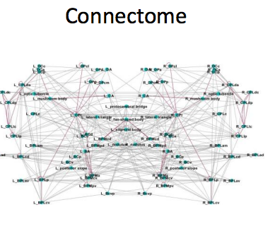
Opportunity
“Unlock the mysteries of the brain”
Identify neural connections
A lot of EM data to be mined
Existing approaches can be improved

Slide 4
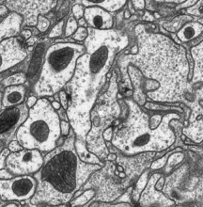
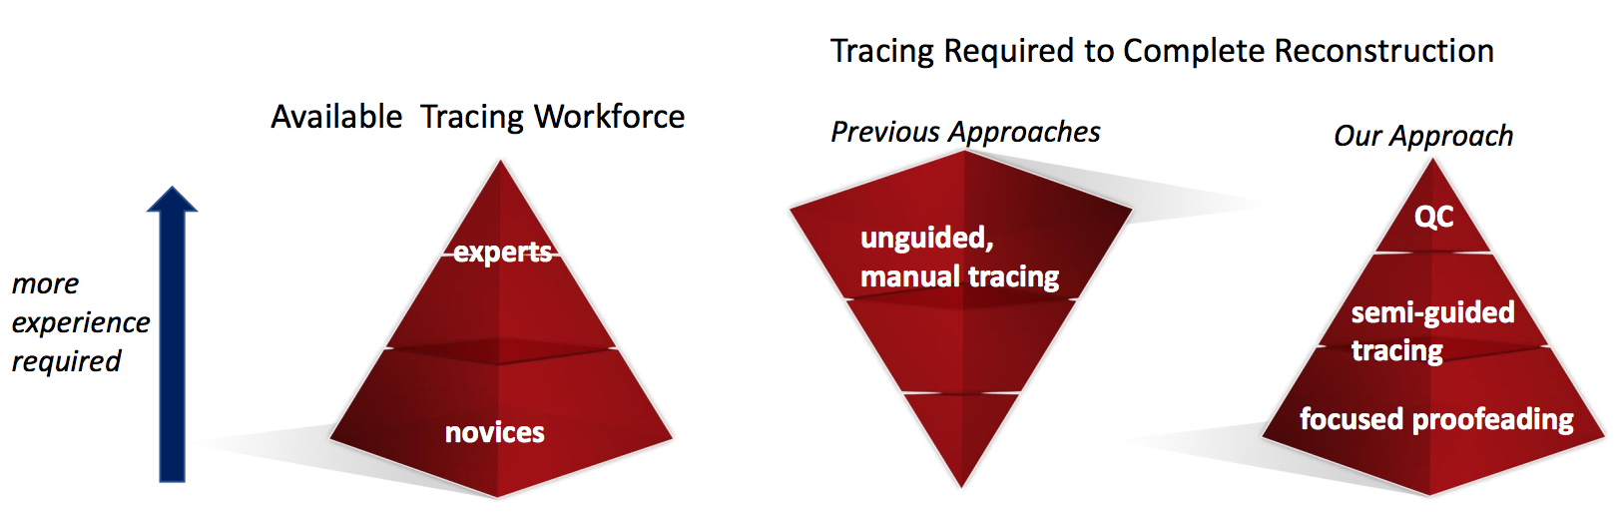
Challenge
Extracting connectomes is time consuming
Manual tracing
Analysis reduced to small areas
Automatic segmentation
False mergers or over segmentation
Large amounts of very detailed EM data
Notes:
Identifying connectomes in EM data can be extremely time consuming because of the sheer size of EM data, and the detail in the data. There are two existing main methods, manual tracing and automatic segmentation, that have a lot of drawbacks. Manual tracing requires a lot of hard work, explain the diagram, and only a small reward. Automatic segmentation requires proofreading afterwards and can lead to a lot of errors.

Slide 5
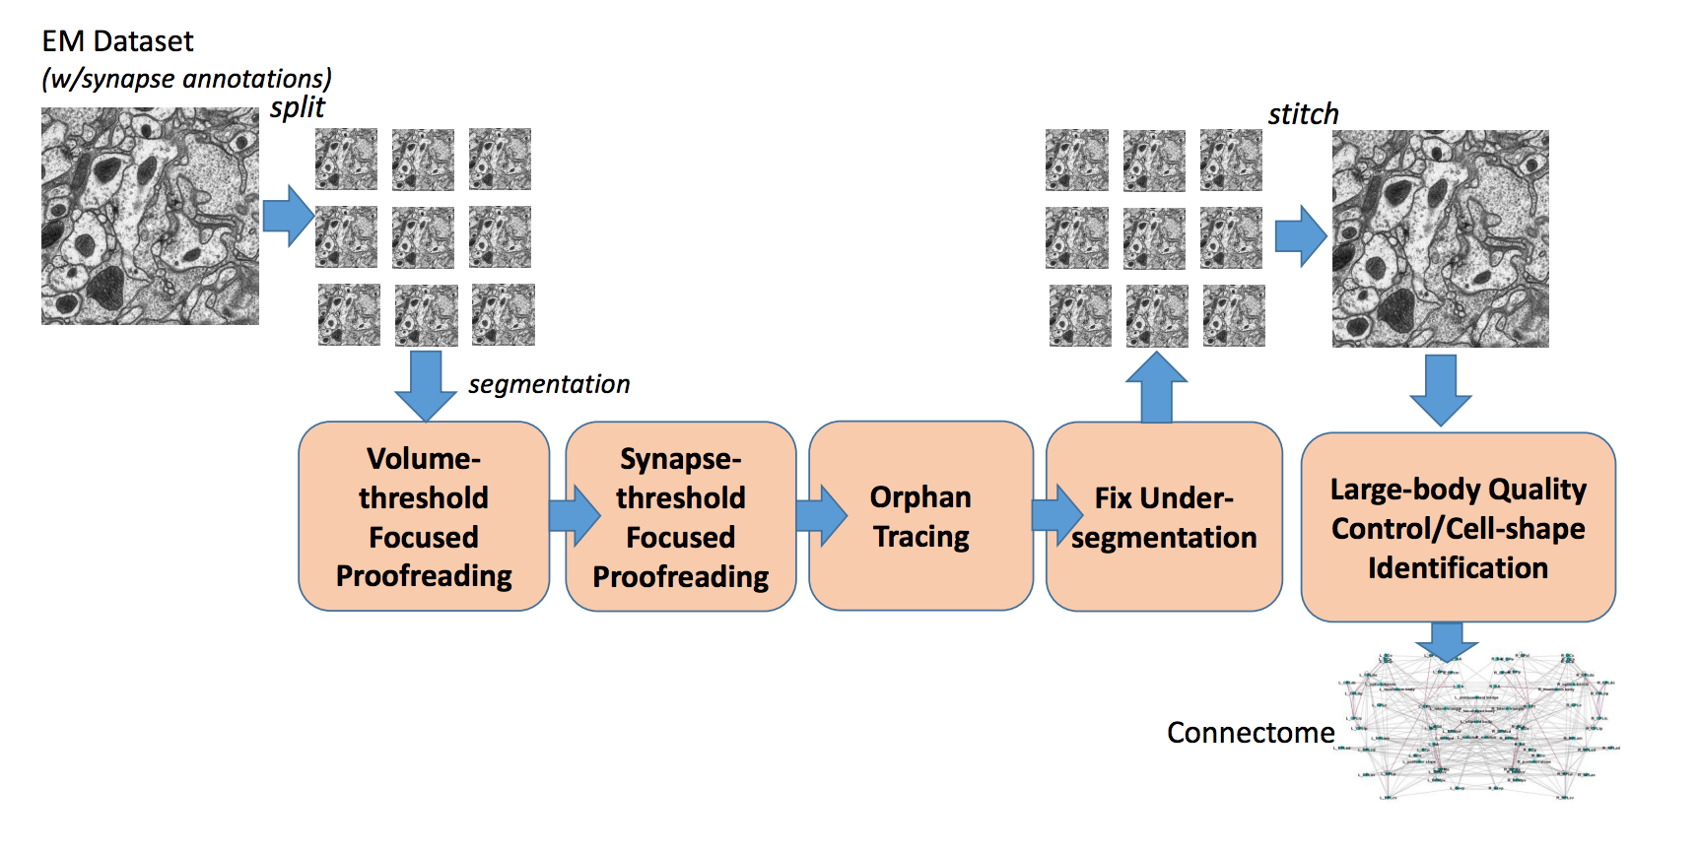
Action
Automatic segmentation – false merging
2 types of proofreading
Depends on biological information – yes/no decisions
Volume threshold proofreading
Synapse threshold proofreading
Improved quality of proofreading – some errors
Notes:
After automatic segmentation takes place (with synapse annotations), some neurons may be falsely merged together, therefore they must be split.
The data goes through two types of proofreading that identify the regions both important to the connectome and most likely to be incorrect after the automatic segmentation.
This proofreading depends on the biological information of the cell and becomes a series of yes/no decisions: volume threshold, which is when the size and volume of the cell is taken into account, and synapse threshold, which is when the location of the synapse is considered.
The quality of proofreading is improved, although some errors are allowed within the thresholds.

Slide 6
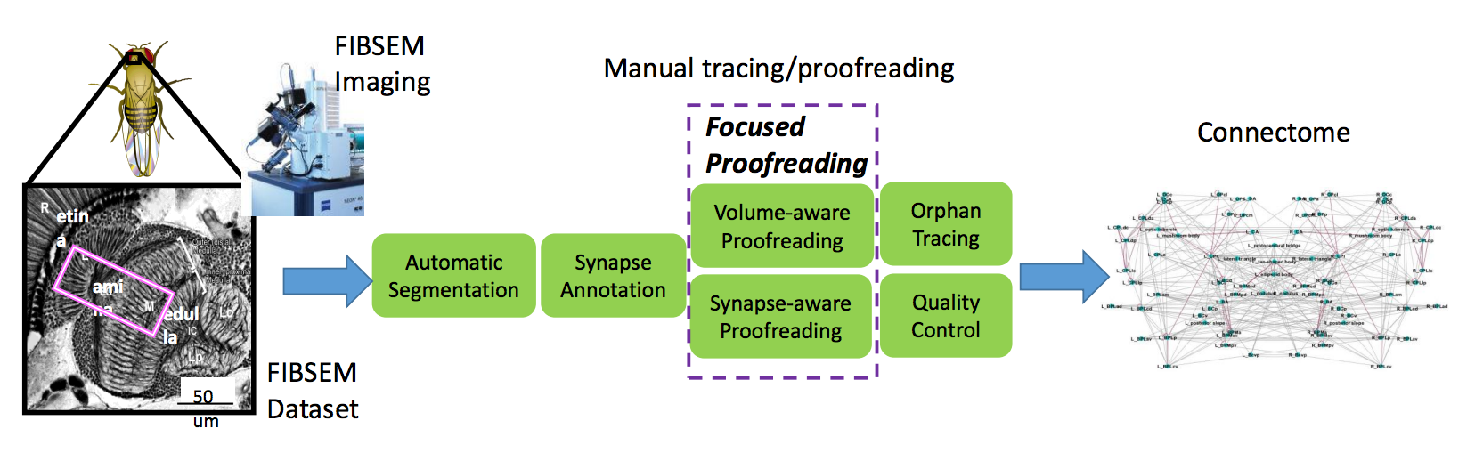
Action
Orphan tracing – looks at nonaligned EM data
Orphaned segments that either contain a synapse or are too large
Segments potentially merged
Sub volumes of EM data joined into global segmentation
Final step: quality control – looking for anomalies
In the paper: Used NeuroProof and data from Drosophila optic lobe
Notes:
The next step is orphan tracing. By looking at nonaligned sets of EM data, the edges of orphaned segments that either contain a synapse or are larger than a certain size are looked at and potentially merged depending on if they are consistent with the known biological information.
The sub volumes of EM data are proofread, then formed together to create a global segmentation of a larger region. The final step is quality control, which involved finding anomalies that simply to do go with the known biological information, such as by looking at the cell-shape or connections between neurons.
In the paper, they used their algorithms in the publicly available tool called NeuroProof, and looked at data from the medulla in the optic nerve of a Drosophila, produced by FIB-SEM imaging.
contains “hundreds of partial neurons and several hundred thousand synaptic connections”

Slide 7
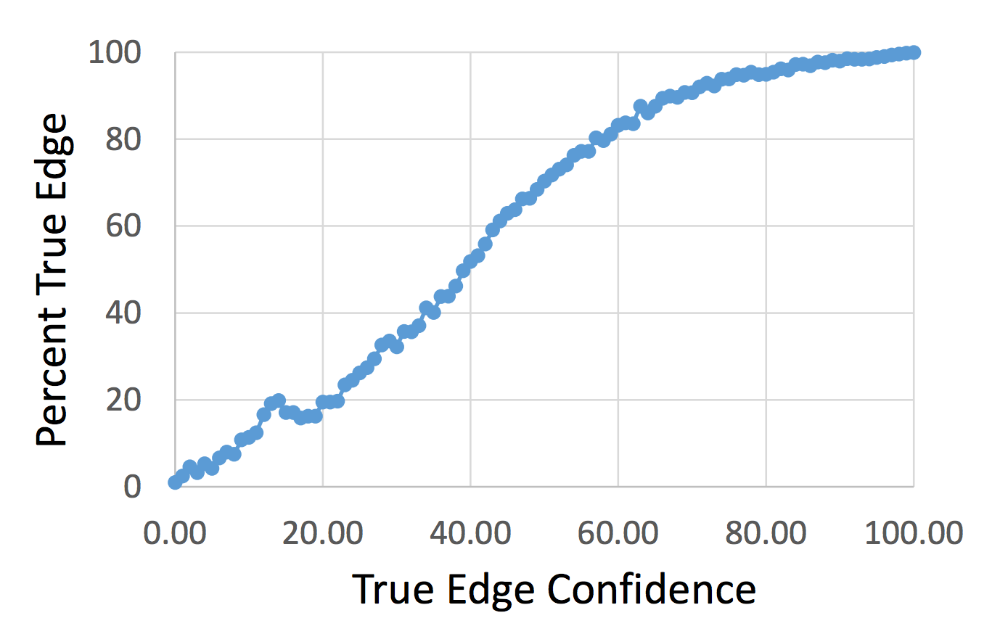
Resolution
Method evaluation and compared
Focused proofreading is more efficient
Number of true edges vs. confidence in true edges
Notes:
Resolution
Their method was evaluated and compared to previous strategies.
Focused proofreading is more efficient (3-5 times faster)
In the table, it shows that there is quite a good correlation between the confidence in the edges found and the percentage of the total edges found. However, as the confidence increases, the number of true edges is underestimated.

Slide 8
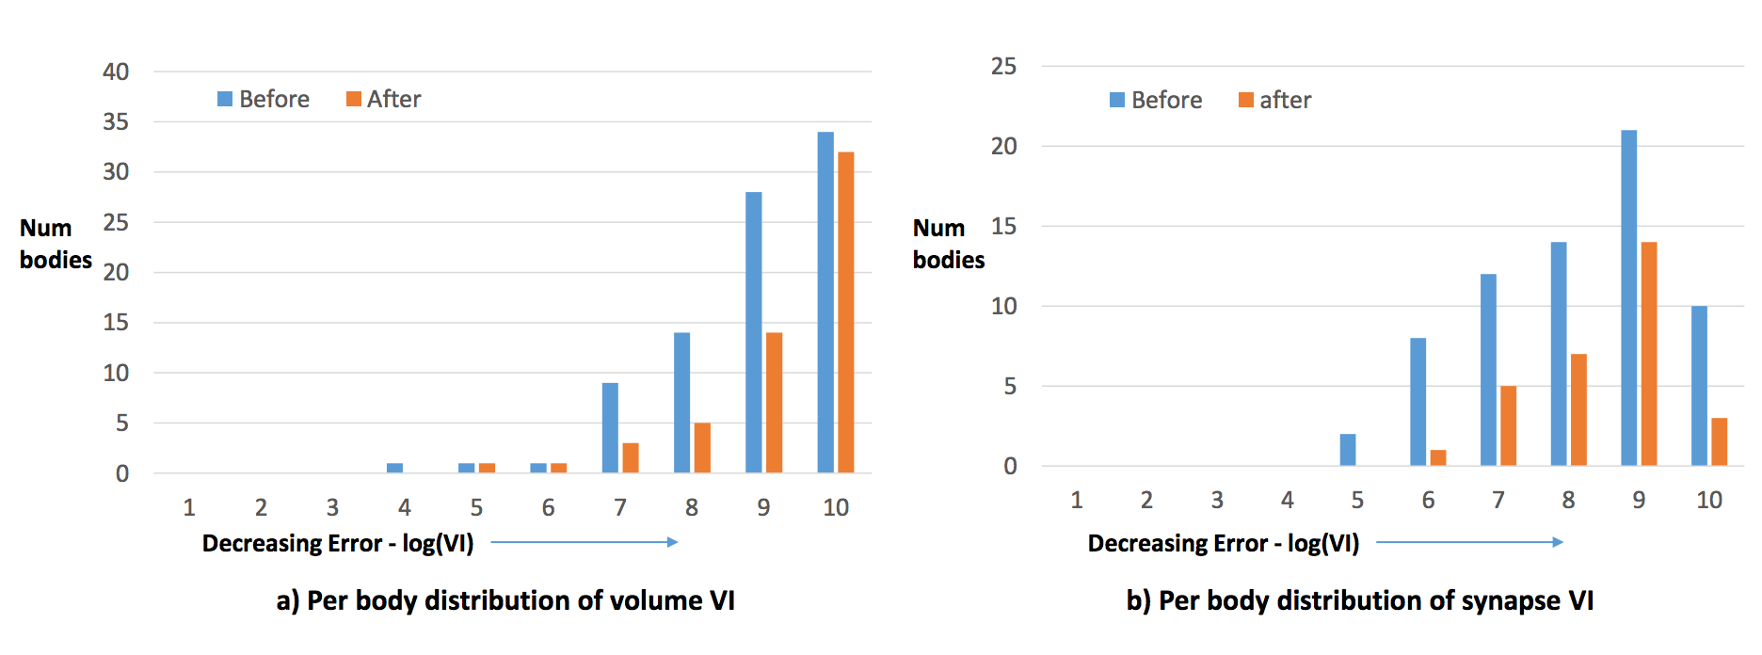
Resolutions
Reduction in error
Notes:
Before: over-segmented EM data
After: after performing the volume and synapse focused proofreading
The distribution shifts to the right, which shows that there is a decreasing error.

Slide 9
Future Work
Improving speed and quality of EM reconstruction
Solving the big question: How does the brain work?
Extract connectomes from mammals or humans?
Further build on proofreader techniques to increase quality and speed
Notes:
Mapping the neural circuits of the brain helps us to see the connections in the brain - how neurons connect to each other. Therefore, by improving the quality and speed at which the EM reconstruction can occur, we are getting closer to solving the big question, how does the brain work? In this experiment, they extracted a complete connectome from the optic lobe of a fly (Drosophila), but in the future, they could apply this same technique (once refined) to the human brain, although it is many times larger and more complex.
In the article, they suggest that greater understanding of biological priors and synaptic connections can further improve proofreading and increase speed.

Slide 10
Discussion
Pros | Cons
Faster EM reconstruction | Much more difficult to map human brain
High quality of connectomes | Still potential errors that focused proofreading ignores
Connectome of Drosophila optic lobe identified
Notes:
Discussion:
Pros:
Speed up
Higher quality
Connector of Drosophila mapped
Cons:
Ultimate goal: mapping human brain, which is still much more complicated

